Slide 1
The Washington Initiative for Community, Language, Education, and Research Support
Whatcom County Language Justice Convening
Web: wp.wwu.edu/langwa/
Kristin Denham, denham@wwu.edu Kirsten Drickey, drickek@wwu.edu Andrew Blick, blicka@wwu.edu

Slide 2
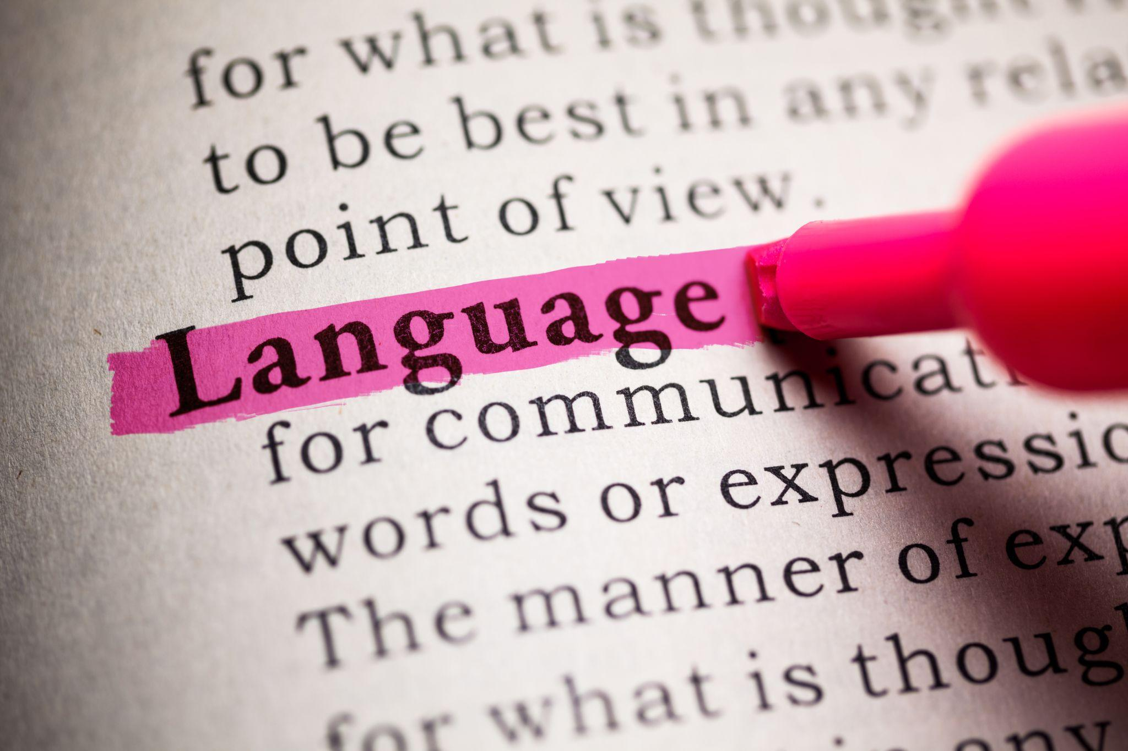
Discussion Overview
Overview of LangWA
Opportunities for Collaboration and Feedback
Survey on Needs in Whatcom and Skagit
Ideas and Initiatives
Open Discussion, Q&A
Image Source: Yu, F. (n.d.). Language. Adobe Stock Images. https://stock.adobe.com/images/language/62900673

Slide 3
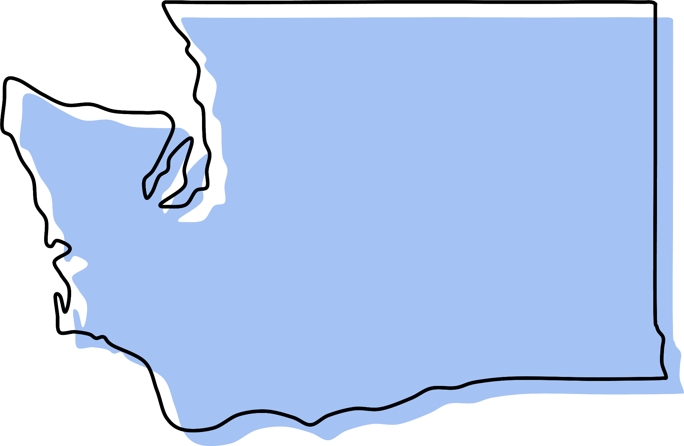
About LangWA
The Washington Initiative for Community, Language, Education, and Research Support (LangWA) will be proposed as a state-wide initiative housed at Western Washington University to expand access to language study and applied linguistics for educators, students, and the broader community.
Image Source: bn. (n.d.). Washington stylized Washington state map. Adobe Stock Images. https://stock.adobe.com/images/washington-stylized-washington-state-map/639333888

Slide 4
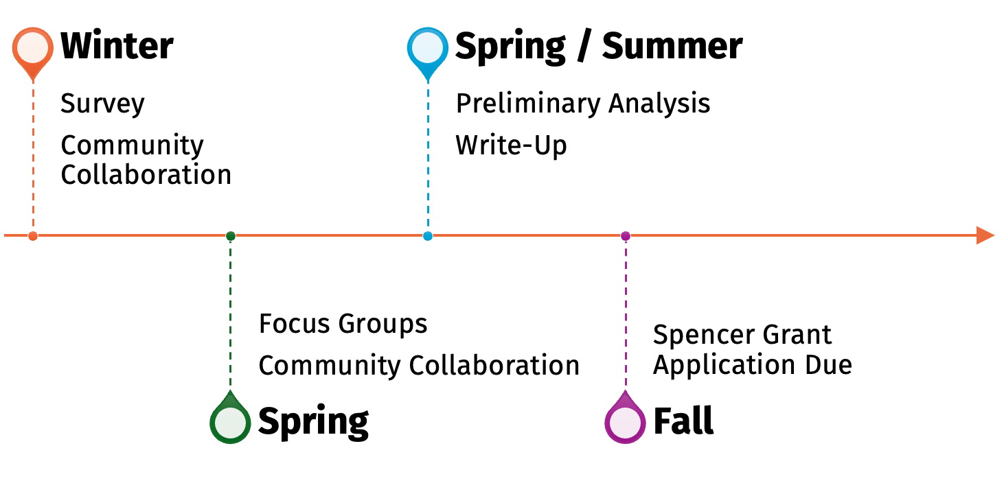
Timeline

Slide 5
Collaboration Opportunities
Interesting in participating in the development of LangWA?
Reach out to…
Network
Engage with Colleagues Across Whatcom and Skagit Counties
Discuss Opportunities for Advisory Board(s)
Co-PIs for Spencer Grant
Image Source: EtiAmmos. (n.d.). Metal Wheel Concept. Adobe Stock Images. https://stock.adobe.com/images/metal-wheel-concept/176482417

Slide 6
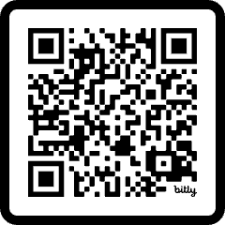
Participate in Our Study!
Use the QR Code on the right (or on the card) to participate in our LangWA Study!
Image Source: Hepta. (n.d.). Survey - letters written in beautiful boxes on white background. Adobe Stock Images. https://stock.adobe.com/images/survey-letters-written-in-beautiful-boxes-on-white-background/225475372
Survey Link: bit.ly/LangWASurvey

Slide 7
Guiding Questions
What are the language needs of Whatcom and Skagit Counties?
What kinds of language support are needed in your organization/the community?
What are the opportunities/challenges your organization faces when collaborating on language-focused initiatives?
What resources and supports would be most helpful for your organization/the community?
Image Source: Kovarzh, K. (n.d.). disegno grafico dialogo tra due persone. Adobe Stock Images. https://stock.adobe.com/images/disegno-grafico-dialogo-tra-due-persone/265461058

Slide 8
Open Discussion:
What are the language resource and support needs you see in the community?
Image Source: ImageFlow. (n.d.). Bright idea and creative thinking. Adobe Stock Images. https://stock.adobe.com/images/bright-idea-and-creative-thinking/314829742

Slide 9
Questions?
Web: wp.wwu.edu/langwa/
Kristin Denham, denham@wwu.edu
Kirsten Drickey, drickek@wwu.edu
Andrew Blick, blicka@wwu.edu

