Slide 1
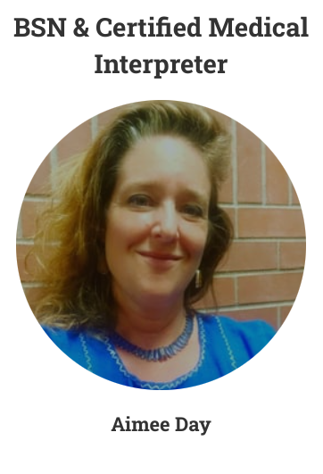
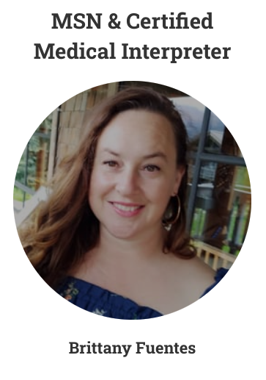
North Sound
Notes:
What we do - Assess, provide organizational reports, write LAPs

Slide 3
Language Access Plans
Medical Providers
Title VI
Executive Order 13166
Public Schools:
Title VI
RCW 28A
Notes:
Both medical facilities and schools required by federal civil rights law to provide interpretation; school districts additionally required by WA to create language access plans by 10/1/22 (which may be phased in). The RCW states that the state “intends” to provide resources for training

Slide 4
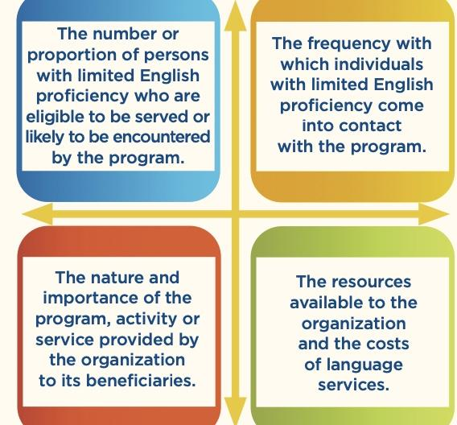
The Four Factors
WA School Directors’ Association LAP (for schools)
Chapter 28A.183 RCW: LANGUAGE ACCESS PROGRAM (for schools)
Language Access Plan Worksheet
(for medical)
Executive Order 13166
Notes:
These sample plans range from very complex to very simple; what matters for schools is that they are required by RCW 28A to develop a plan that has certain elements (described in RCW 28A)
The four factors was developed to help orgs visualize overall need and gauge abilities

Slide 5
Elements/Steps of a LAP
Define and Assess needs of population served
2) Self-Assess current practices and resources
3) Develop clear procedures
4) Develop staff training
5) Periodic evaluation and revision
Languages spoken at home (mapped by county)
Stakeholder Input
Notes:
This is where NS LEAP can help out - carry out department by department
Assessments and make specific recommendations - organizational report
1) your org might already have demographic info, if large like a school district, otherwise public tools and reports
2) department by department ASK stakeholders as well as staff
3) How-to: what steps to take in given situations. HOW to get a telephone interpreter for example with out hanging up on somebody - procedures should be based on best practices. For schools, these are outlined in RCW 28A
4) training should include rationale and principles of language justice as well as P@P
5) with stakeholder involvement (surveys, conversations, etc)

Slide 6
Implementation: in the “Real World”
Points of contact (telephone, website, reception)
Modality (in-person, video, telephone)
Translation of documents (“vital” documents”)
Staff training
Notes:
Particular points in language service provision that need special attention
Reception - telephone especially, speaking anecdotally as a working interpreter, no-shows are often due to difficulty communicating by phone.
Modality - choice of modality complex decision (financial, scheduling, etc) but there is a near universal preference for in-person interpretation (from both sides) for its flexibility and ease of use - no technical issues! Less error prone
Documents - Vital documents required by law (schools), but staff needs to be able to find them .
Training - past surveys have found staff unaware of legal requirements, feel unsure about P&P

Slide 7
Who Can Interpret?
WA certified Medical or Social Services interpreters
Authorized/Qualified/Credentialed interpreters - variously defined RCW 28A.183.080)
Bilingual staff - should be authorized/credentialed
AI “google” - being increasingly used, be mindful of limitations
Who Shouldn’t Interpret?
Family members, children
*Emergent situations*
Notes:
Best Practices; listed in order of preference
Authorized - generically defined as “having been proficiency tested in some way”
Bilingual Staff - being bilingual is not the same skill set as trained interpreter (ethics, HIPPA, specialized vocabulary, etc etc)
Google stories “pulse” translated as “lentil” - HAS A PLACE “parent net” apps and doctors instructions on visit summaries for example
Family members and children - easy to imagine why inappropriate in both medical and school settings
Emergent situations; Can this interaction be scheduled? (ie discipline).Can it wait 10 minutes to get video interpretation? Can it wait TWO minutes for telephone interpretation?

Slide 8
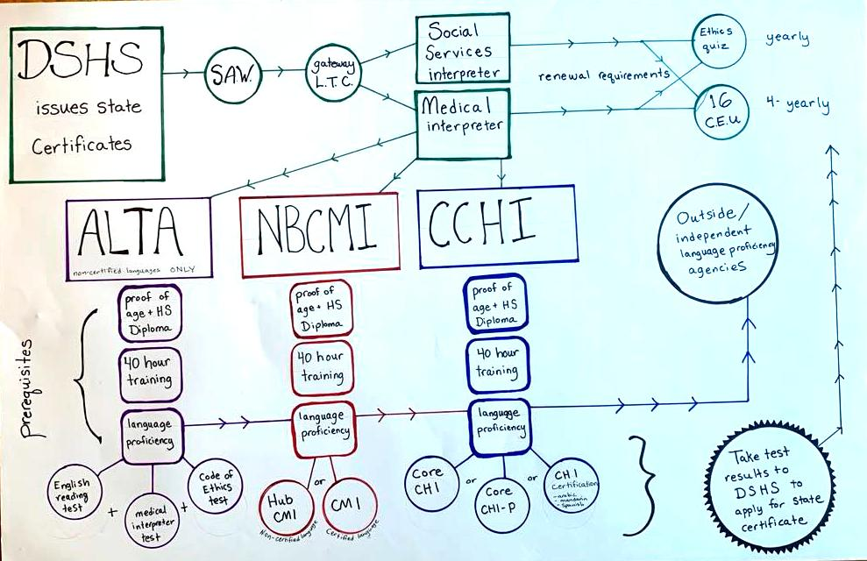
Path to State Certification
Notes:
Bring out the trifold diagram - point out disconnect for LDD For MEDICAL

Slide 9
Possible Barriers to Certification
Acquiring Documents from Home Countries
Costs (Translation, Testing, Etc)
Computer/Tech experience
Time and Transportation
Languages with no clear path to certification
Notes:
Documentation may not exist (LLD) and when it does needs to be sent ($$$) and translated ($$$)
Most candidates will be trying to certify on top of working full time, cannot take weeks off to complete training, childcare etc - medical interpretation is not a full time job, esp. In LLD
Many from these communities only use mobile phones, don’t have access to desktop (not all sites you have to engage with are accessible)

